Slide 1
Reducing Variability in Gym Attendance to Improve Operational Consistency

Slide 2
Business Case
This project seeks to reduce fluctuations in weekday gym attendance across three key time slots (morning, afternoon, evening). By improving consistency in usage patterns, the gym can better align staffing, equipment availability, and facility management to actual demand. This leads to more stable operations and a better member experience.
Cost-Benefit Analysis:
Costs:
Time: Staff or personal time spent observing and collecting data.
Minor resource use for data tracking tools (spreadsheets, observation logs, etc.)
Benefits:
Increased operational consistency and scheduling efficiency
Improved member satisfaction due to reduced crowding or underuse
More predictable demand planning for equipment and facilities
Data-informed staffing to reduce over- or under-staffing during key hours.
DEFINE

Slide 3
Business Case
Why This Project is Important:
Customer Experience: Inconsistent gym usage leads to overcrowded or underutilized time slots, negatively affecting access to equipment and overall member satisfaction.
Operational Efficiency: Reducing variability in attendance helps streamline staff scheduling and facility use, minimizing waste and maximizing impact.
Resource Optimization: Knowing when the gym is consistently overused/underused allows for proactive adjustments that improve flow, equipment readiness, and overall environment.
Long-Term Impact: Consistent usage patterns can drive retention, improve first impressions for new members, and create a more stable operating rhythm.

Slide 4
Problem & Goal Statement
Y Metric: Attendance Variability Score Measured as the standard deviation of gym attendance across time blocks (Morning, Afternoon, Evening) during weekdays.
Problem: The gym experiences high variability in member attendance across different weekday time slots, resulting in unpredictable demand for equipment and staff support. This inconsistency makes it difficult to schedule resources effectively and negatively impacts the customer experience during peak or unexpectedly low periods.
Goal: To reduce variability in weekday gym attendance by identifying and analyzing the key factors driving inconsistency. The goal is to support more consistent operational planning, improve equipment and space utilization, and enhance the member experience through more predictable traffic flow.
DEFINE

Slide 5
Operational Definition
Attendance Variability Score — defined as the standard deviation of daily attendance counts within each time block (Morning: 7–9 AM, Afternoon: 12–2 PM, Evening: 7–9 PM), measured over a fixed period (February 3–21, 2025, weekdays only).
How It’s Measured:
Attendance is recorded for each weekday in all three time slots.
The standard deviation of attendance is calculated within each time block over the 3-week period.
Higher SD indicates more variability (meaning attendance fluctuates from day to day); lower SD reflects consistent usage.
Purpose:
Measures the predictability of gym usage, enabling staff to align scheduling, equipment availability, and resource planning with actual member flow patterns.
MEASURE

Slide 6
Current State
Gym attendance across weekday time slots is highly variable.
Some time blocks show consistent usage, while others fluctuate significantly from day to day.
This inconsistency makes it difficult to predict demand, allocate staff, and manage equipment availability.
The current state was measured using data collected from February 3 to 21, 2025 (weekdays only), across three time blocks:
Morning (7–9 AM)
Afternoon (12–2 PM)
Evening (7–9 PM)
MEASURE

Slide 7
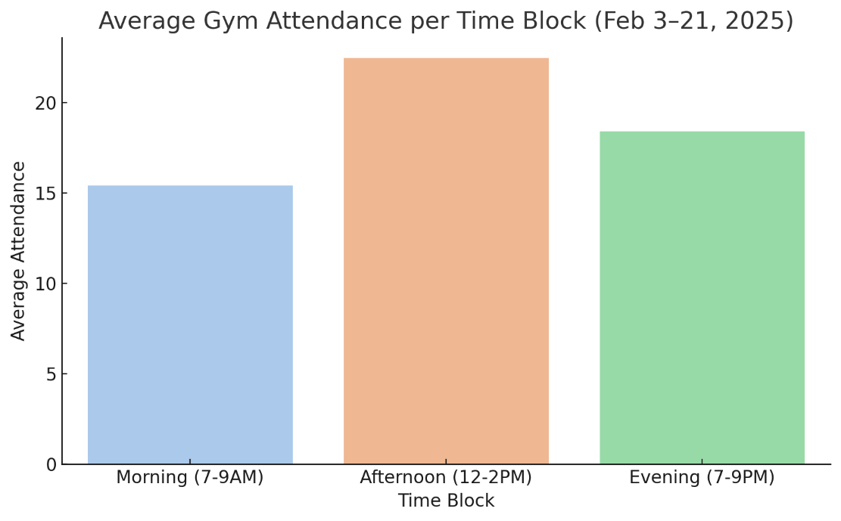
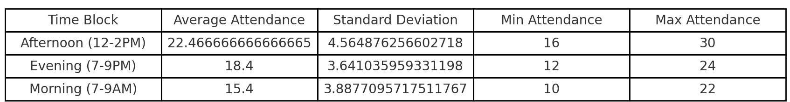
Current State – Descriptive
Afternoon (12–2PM) has the highest average attendance.
Evening (7–9PM) follows.
Morning (7–9AM) has the lowest average attendance.
The Standard Deviation (SD) shows how much attendance fluctuates:
Afternoon has the highest SD, meaning attendance is inconsistent and less predictable.
Morning has the lowest SD, indicating more stable turnout.
MEASURE

Slide 8
Current State – DPMO & Sigma Level
To evaluate consistency in gym attendance, we defined a defect as any time slot where attendance dropped below 15 individuals. This threshold reflects operational difficulty due to low turnout.
Total Time Slots Observed: 45
Defective Time Slots: 9
DPMO (Defects Per Million Opportunities): 200,000
Estimated Sigma Level: 2.34 σ
This reflects a moderate level of process variation, suggesting opportunities to improve predictability and resource planning, especially during low-attendance periods.
MEASURE

Slide 9
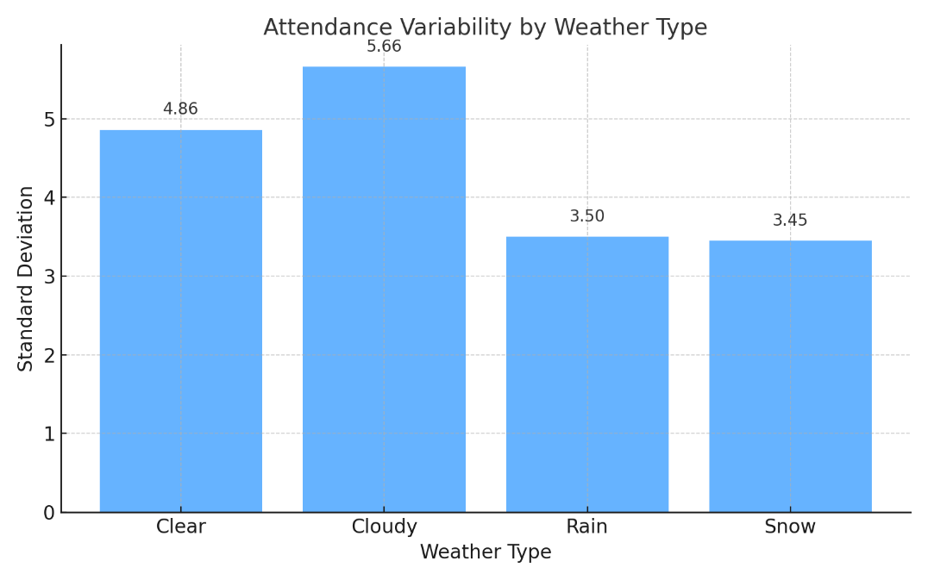
Analysis - Attendance Variability by Weather
Cloudy days have the highest variability (SD = 5.66), suggesting unpredictable attendance.
Clear days are more consistent but still show notable fluctuation.
Rainy and snowy days have lower variability, but also lower average attendance, meaning they suppress usage rather than destabilize it.
ANALYZE

Slide 10
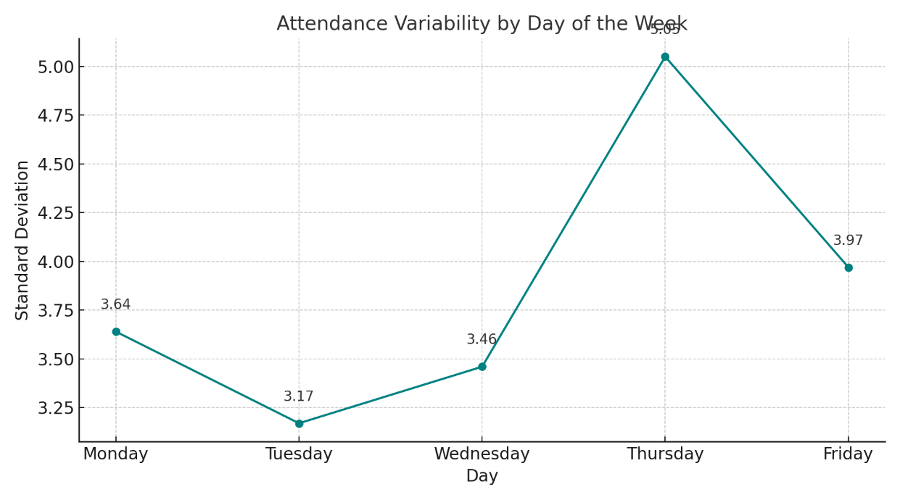
Analysis - Attendance Variability by Day
Thursday stands out with the highest variability (SD = 5.05), suggesting highly unpredictable gym usage.
Tuesday and Wednesday are the most consistent, with lower standard deviations.
The pattern indicates that mid- to late-week planning is less predictable, which may impact staffing or equipment readiness.
Targeting Thursday scheduling or member engagement could help reduce overall attendance variability.
Day | Average Attendance | Standard Deviation | Observations
Monday | 19.44 | 3.64 | 9
Tuesday | 17.56 | 3.17 | 9
Wednesday | 15 | 3.46 | 9
Thursday | 17.33 | 5.05 | 9
Friday | 24.44 | 3.97 | 9
ANALYZE

Slide 11
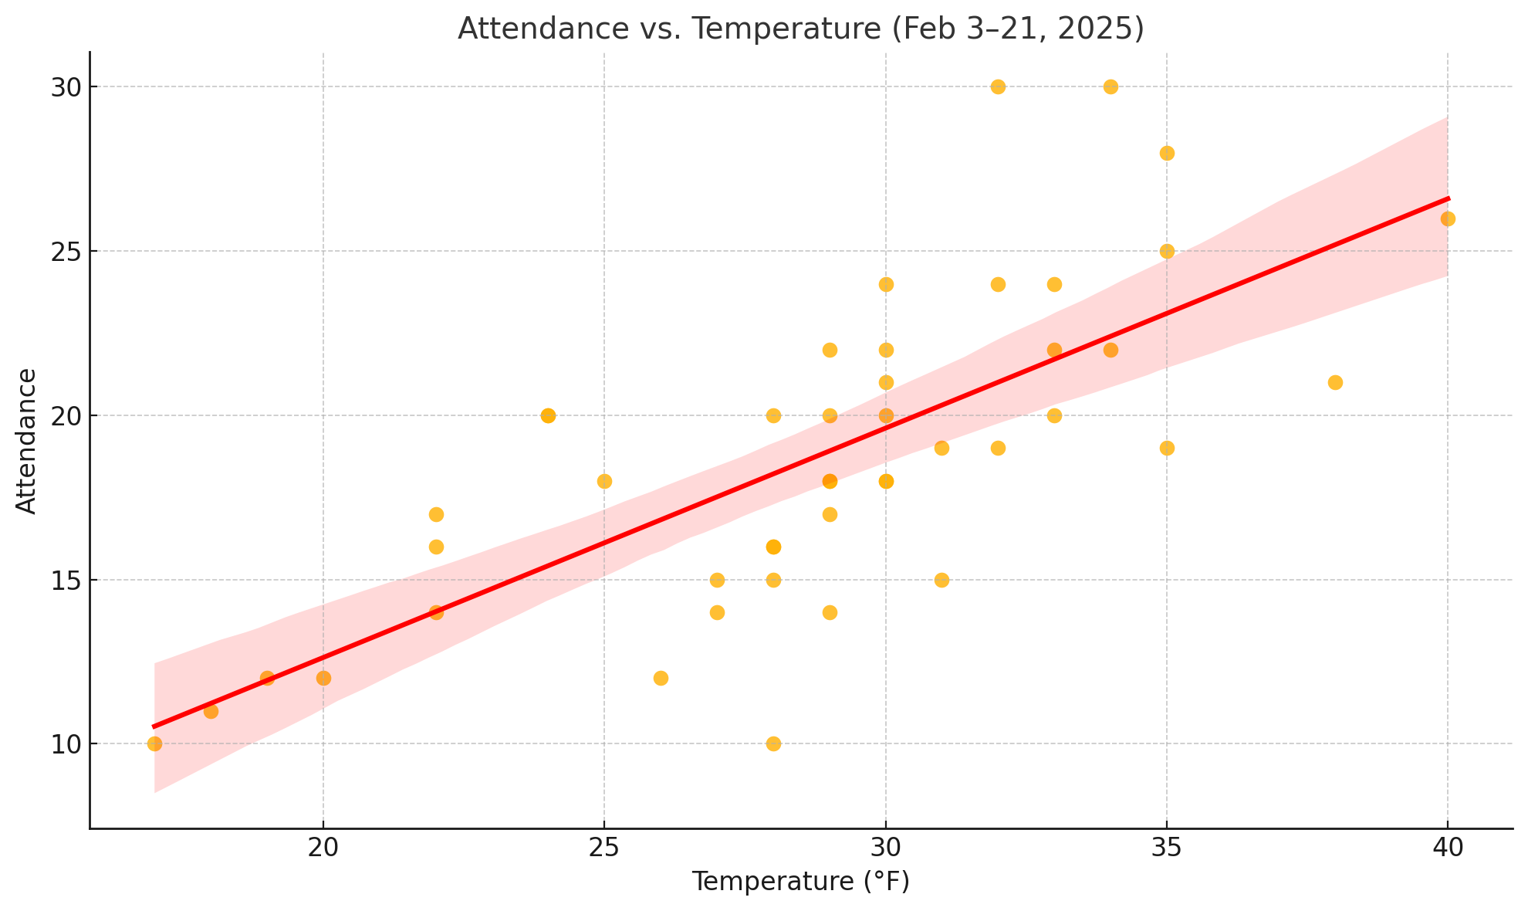
Attendance Variability by Temperature
Positive correlation between temperature and gym attendance.
Attendance tends to be lower on colder days, especially below 25°F.
As temperatures rise, attendance generally increases, suggesting weather comfort may influence member motivation.
While the trend isn’t perfect, the regression line highlights a clear upward pattern, supporting the idea that temperature is a contributing X to attendance variability.
ANALYZE

Slide 12
Recommendations
Adjust Staffing and Equipment Allocation on Thursdays
X Factor: Day of Week
Finding: Thursday had the highest attendance variability (SD = 5.05)
Action: Introduce flexible staffing plans and staggered equipment resets on Thursdays to better accommodate unpredictable demand
Launch Targeted Messaging on Colder Days
X Factor: Temperature
Finding: Colder temperatures correlated with lower and more variable attendance
Action: Send motivational push notifications or in-app reminders on forecasted cold mornings to encourage consistent attendance
Add Staff Briefings or On-Demand Coverage for Thursdays
X Factor: Day of Week
Finding: Thursday showed the highest variability in attendance
Action: Implement short pre-shift briefings for staff on Thursdays and prepare a standby rotation for flexible support if turnout is unusually high.
RECOMMENDATIONS

Slide 13
Recommendations – Control
Weekly Monitoring of Attendance Variability
Continue tracking SD by time block using the existing attendance log
Identify any new spikes in variability for proactive response
Staff Coverage Tracker
Log actual vs. scheduled staffing levels on Thursdays
Ensure flexible coverage protocols remain in effect
Temperature-Triggered Alerts
Automate reminders to send motivational messages on days below 25°F
Review engagement metrics monthly to refine messaging
RECOMMENDATIONS

Slide 14
Appendix A: Data Collection
Date | Day | Time Block | Attendance | Temperature (°F) | Weather
2/3/2025 | Monday | Morning (7-9AM) | 15 | 31 | Clear
2/3/2025 | Monday | Afternoon (12-2PM) | 25 | 35 | Clear
2/3/2025 | Monday | Evening (7-9PM) | 20 | 33 | Clear
2/4/2025 | Tuesday | Morning (7-9AM) | 18 | 30 | Cloudy
2/4/2025 | Tuesday | Afternoon (12-2PM) | 22 | 34 | Cloudy
2/4/2025 | Tuesday | Evening (7-9PM) | 19 | 32 | Cloudy
2/5/2025 | Wednesday | Morning (7-9AM) | 12 | 26 | Snow
2/5/2025 | Wednesday | Afternoon (12-2PM) | 20 | 28 | Snow
2/5/2025 | Wednesday | Evening (7-9PM) | 15 | 27 | Snow
2/6/2025 | Thursday | Morning (7-9AM) | 10 | 28 | Rain
2/6/2025 | Thursday | Afternoon (12-2PM) | 18 | 30 | Rain
2/6/2025 | Thursday | Evening (7-9PM) | 14 | 29 | Rain
2/7/2025 | Friday | Morning (7-9AM) | 20 | 30 | Clear
2/7/2025 | Friday | Afternoon (12-2PM) | 28 | 35 | Clear
2/7/2025 | Friday | Evening (7-9PM) | 22 | 33 | Clear
2/10/2025 | Monday | Morning (7-9AM) | 17 | 29 | Cloudy
2/10/2025 | Monday | Afternoon (12-2PM) | 24 | 33 | Cloudy
2/10/2025 | Monday | Evening (7-9PM) | 19 | 31 | Cloudy
2/11/2025 | Tuesday | Morning (7-9AM) | 16 | 28 | Snow
2/11/2025 | Tuesday | Afternoon (12-2PM) | 21 | 30 | Snow
2/11/2025 | Tuesday | Evening (7-9PM) | 18 | 29 | Snow
2/12/2025 | Wednesday | Morning (7-9AM) | 14 | 27 | Rain
2/12/2025 | Wednesday | Afternoon (12-2PM) | 20 | 29 | Rain
2/12/2025 | Wednesday | Evening (7-9PM) | 16 | 28 | Rain
2/13/2025 | Thursday | Morning (7-9AM) | 19 | 35 | Clear
2/13/2025 | Thursday | Afternoon (12-2PM) | 26 | 40 | Clear
2/13/2025 | Thursday | Evening (7-9PM) | 21 | 38 | Clear
2/14/2025 | Friday | Morning (7-9AM) | 22 | 29 | Cloudy
2/14/2025 | Friday | Afternoon (12-2PM) | 30 | 34 | Cloudy
2/14/2025 | Friday | Evening (7-9PM) | 24 | 32 | Cloudy
2/17/2025 | Monday | Morning (7-9AM) | 15 | 28 | Snow
2/17/2025 | Monday | Afternoon (12-2PM) | 22 | 30 | Snow
2/17/2025 | Monday | Evening (7-9PM) | 18 | 29 | Snow
2/18/2025 | Tuesday | Morning (7-9AM) | 12 | 19 | Clear
2/18/2025 | Tuesday | Afternoon (12-2PM) | 18 | 25 | Clear
2/18/2025 | Tuesday | Evening (7-9PM) | 14 | 22 | Clear
2/19/2025 | Wednesday | Morning (7-9AM) | 10 | 17 | Cloudy
2/19/2025 | Wednesday | Afternoon (12-2PM) | 16 | 22 | Cloudy
2/19/2025 | Wednesday | Evening (7-9PM) | 12 | 20 | Cloudy
2/20/2025 | Thursday | Morning (7-9AM) | 11 | 18 | Snow
2/20/2025 | Thursday | Afternoon (12-2PM) | 17 | 22 | Snow
2/20/2025 | Thursday | Evening (7-9PM) | 20 | 24 | Snow
2/21/2025 | Friday | Morning (7-9AM) | 20 | 24 | Cloudy
2/21/2025 | Friday | Afternoon (12-2PM) | 30 | 32 | Cloudy
2/21/2025 | Friday | Evening (7-9PM) | 24 | 30 | Cloudy
DATA COLLECTION

